Slide 1
Unsupervised Learning
Deasy Indrawati dan Leonard Yulianus
PJJ Data Analytics

Slide 2
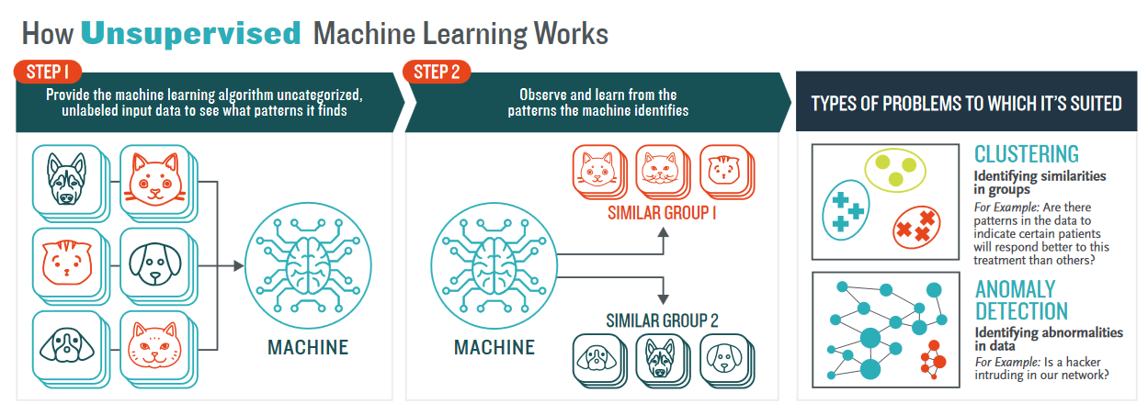
Notes:
klo unsupervised bukan meng-klasifikasi-kan ya tp melakukan clustering
klasifikasi → kita sdh pny label, sdh tau pengelompokannya mau spt apa
kluster → mengelompokkan berdasarkan kemiripan, blm ada label sebelumnya

Slide 3
Unsupervised Learning
Unsupervised learning uses machine learning algorithms to analyze and cluster unlabeled data sets. These algorithms discover hidden patterns in data without the need for human intervention (hence, they are “unsupervised”).

Slide 4
The Advantages
Suitable for problem where labeled data is scarce or expensive to obtain
Get insights from large volumes of new data, might discover patterns that are not obvious at first

Slide 5
The Challenges
Computationally complex because they need a large training set to produce intended outcomes
Still need human intervention to validate the outputs

Slide 6
Main Tasks in Unsupervised Learning
Clustering
Groups unlabeled data based on their similarities or differences
Helpful for market segmentation, image compression
Dimensionality Reduction
Reduces the number of data inputs to a manageable size while preserving the data integrity
Used in the preprocessing data stage, such as when autoencoders remove noise from visual data to improve picture quality
Association Rule Learning
Uses different rules to find relationships between variables in a given dataset
Frequently used for market basket analysis and recommendation engines (Customers Who Bought This Item Also Bought)

Slide 7
Clustering

Slide 8
Clustering
Partition-based clustering
K-means
K-medoids
Hierarchical clustering
Agglomerative (AGNES)
Divisive (DIANA)
Distribution-based clustering
Gaussian Mixture Model (GMM)
Density-based clustering
Density-Based Spatial Clustering of Applications with Noise (DBSCAN)
Ordering Points To Identify the Clustering Structure (OPTICS)
Source: Xu, D., Tian, Y. A Comprehensive Survey of Clustering Algorithms. Ann. Data. Sci. 2, 165–193 (2015).

Slide 9
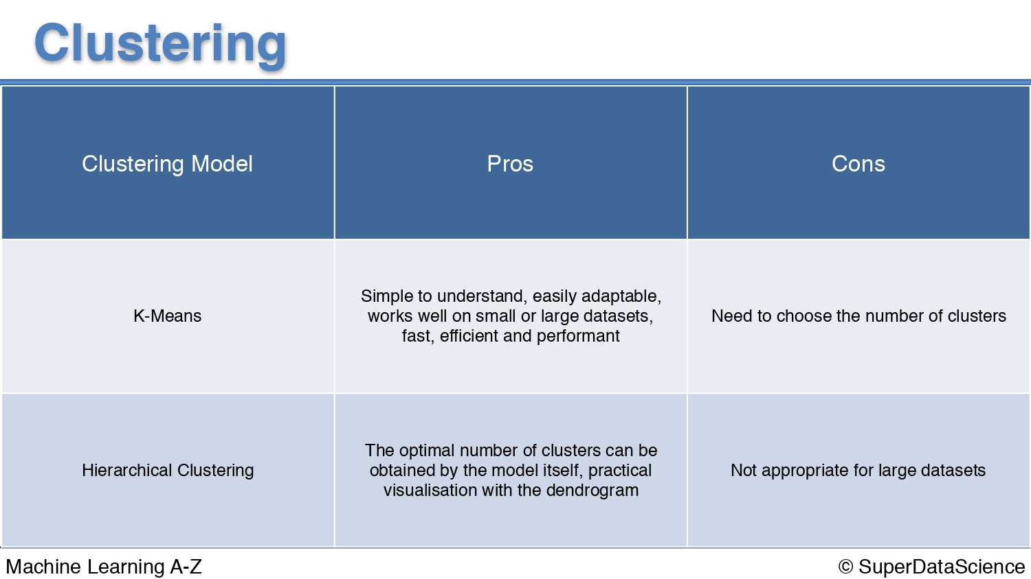

Slide 10
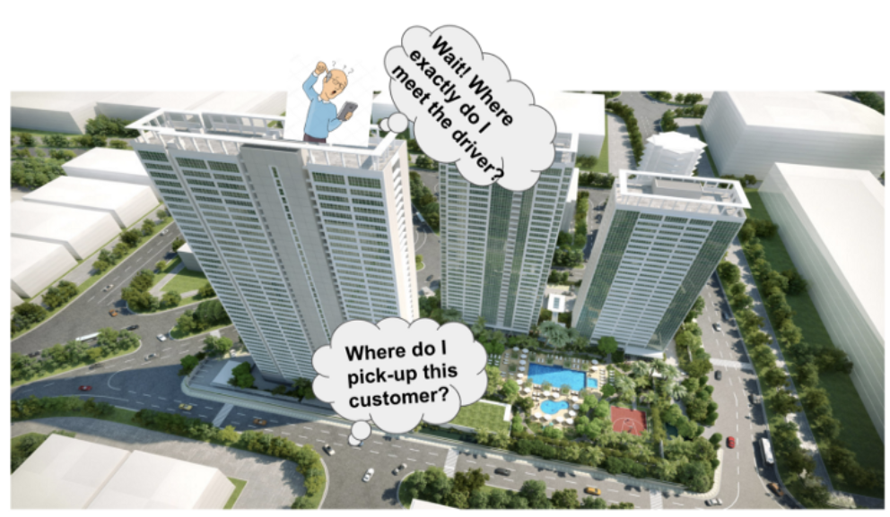
Study Case (GOJEK Meeting Points)

Slide 11
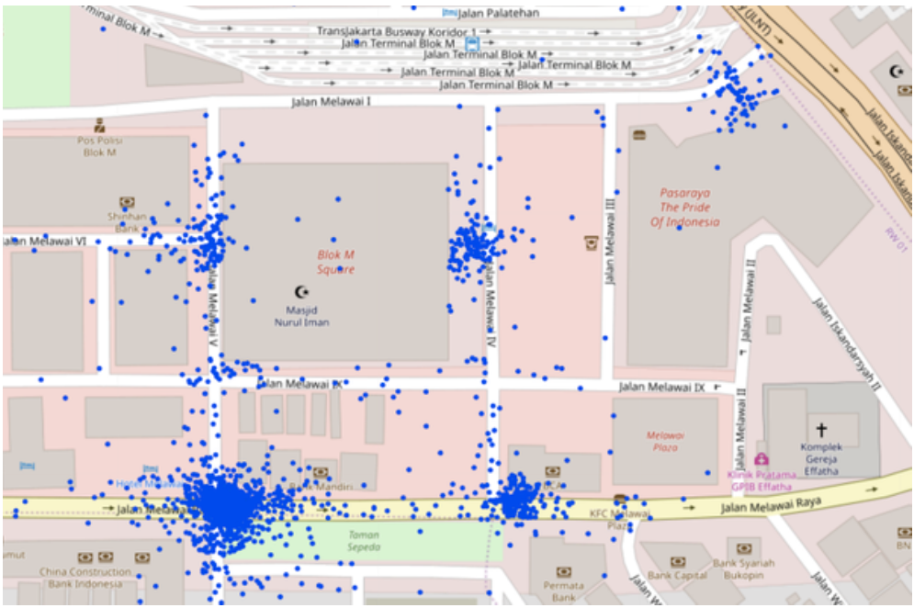
Project’s Target
Determine meeting point (gates) of any Place of Interest (POI) based on historical driver pick up data.
POI Example: Blok M Square

Slide 12
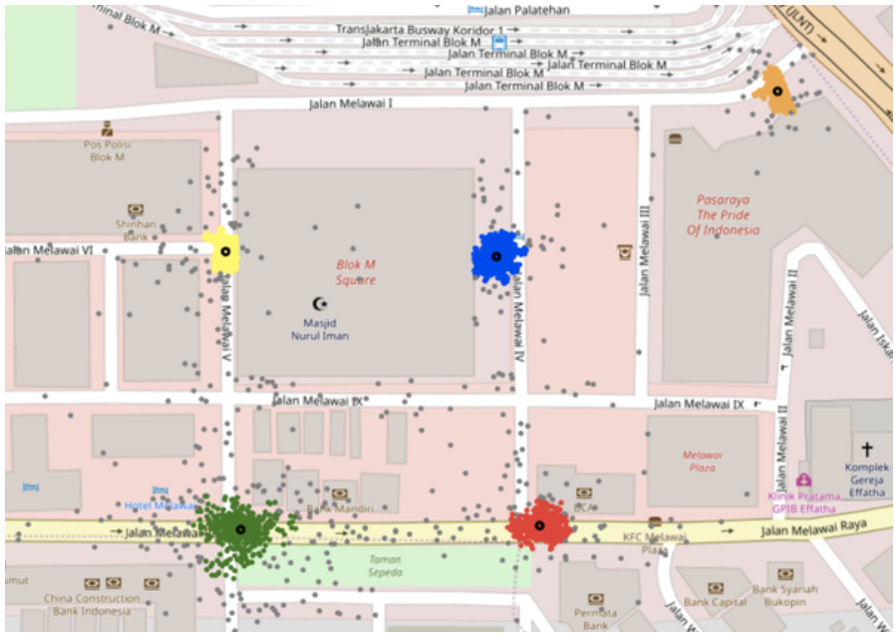
Using DBSCAN
After some hyperparameter tuning (eps and min_samples), the result is 5 clusters for determining gates on Blok M Square

Slide 13
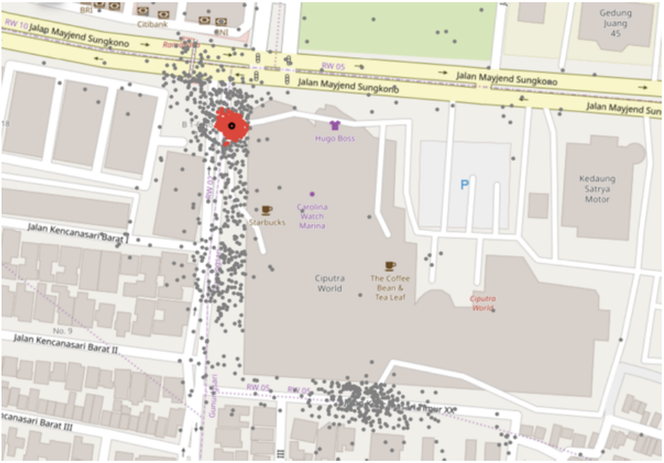
POI : Ciputra World
Datapoints are spread, DBSCAN can’t determine clusters

Slide 14
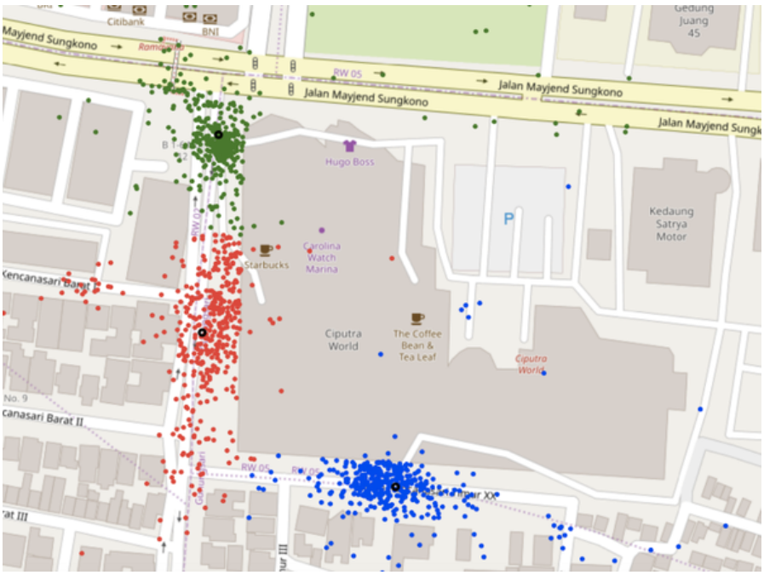
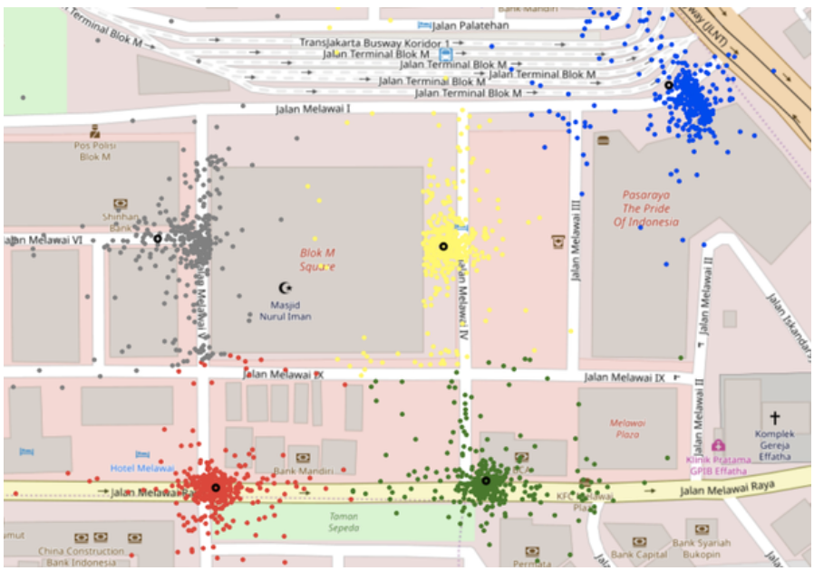
Using K-means
Ciputra World
Blok M Square
Different POIs may have different number of gates, but K-means has a fix value of K. How to find the best K value for each POI

Slide 15
Clustering Evaluation
Mengukur kedekatan dalam cluster, dan pemisahan antar cluster yang berbeda
Cluster yang baik : Compact, Separated
Ukuran evaluasi clustering:
Silhouette Index
Davies-Bouldin Index
Dunn Index

Slide 16
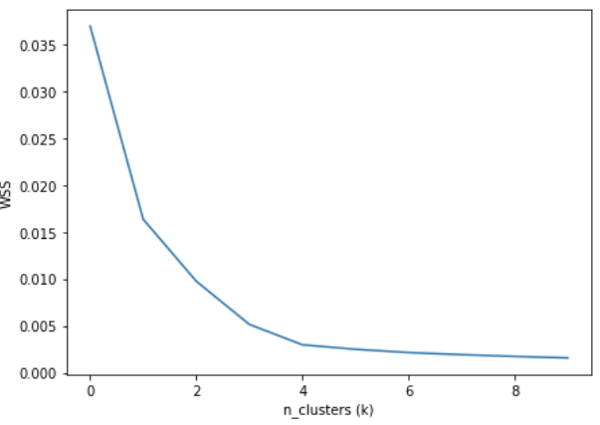
Within-cluster Sum of Squared Approach
Find diminishing point (elbow) on WSS curve
Sum of squared error of each data point on the same cluster
Optimal K value is between 4 and 6

Slide 17
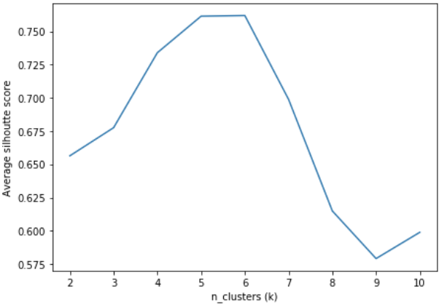
Silhouette Score Approach
Find the maximum point of average silhouette score
Silhouette Score Approach
The silhouette value measures how similar a point is to its own cluster (cohesion) compared to other clusters (separation).
Optimal K value is 5 or 6

